Slide 1

Document Flashcard Generator
Automating flashcard creation using large language models (LLMs).
Presented by: Group 42
Mohamed Faiz V S (22BTRCN173)
Karthik Jadhav (22BTRCN135)
K S Sirisha (22BTRCN129)
Shashank.S (22BTRCN257)
Y Chandana (22BTRCN330)

Slide 2

Introduction
Manual Creation Challenges
AI Automation Potential
Project Motivation
Leveraging AI and LLMs to speed up flashcard generation.
Create efficient, AI-powered study aids.
Time-consuming and labor-intensive process.

Slide 3
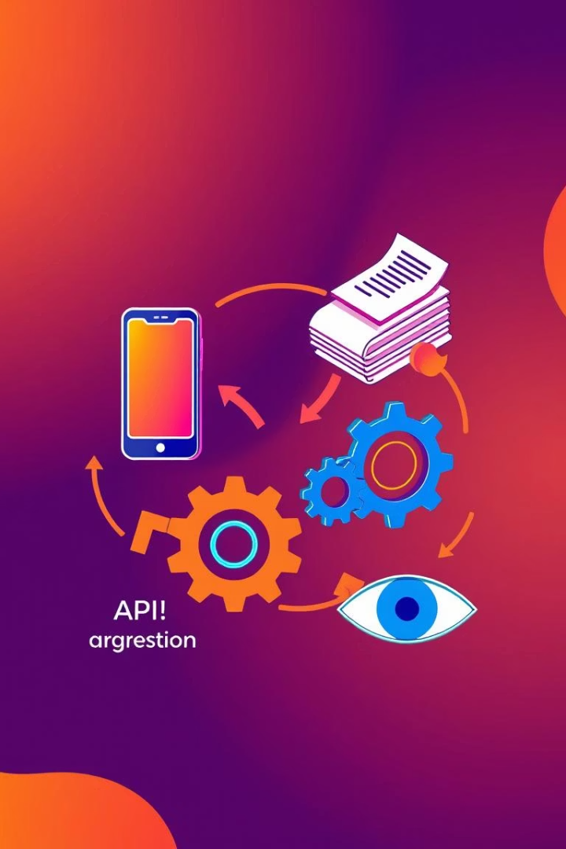
Project Objectives
Web App
Build intuitive flashcard generation interface.
Document Support
Handle PDF, DOCX, and PPTX file uploads.
Gemini API
Integrate for streaming flashcard content.
Design
Employ modern glassmorphic UI style.

Slide 4
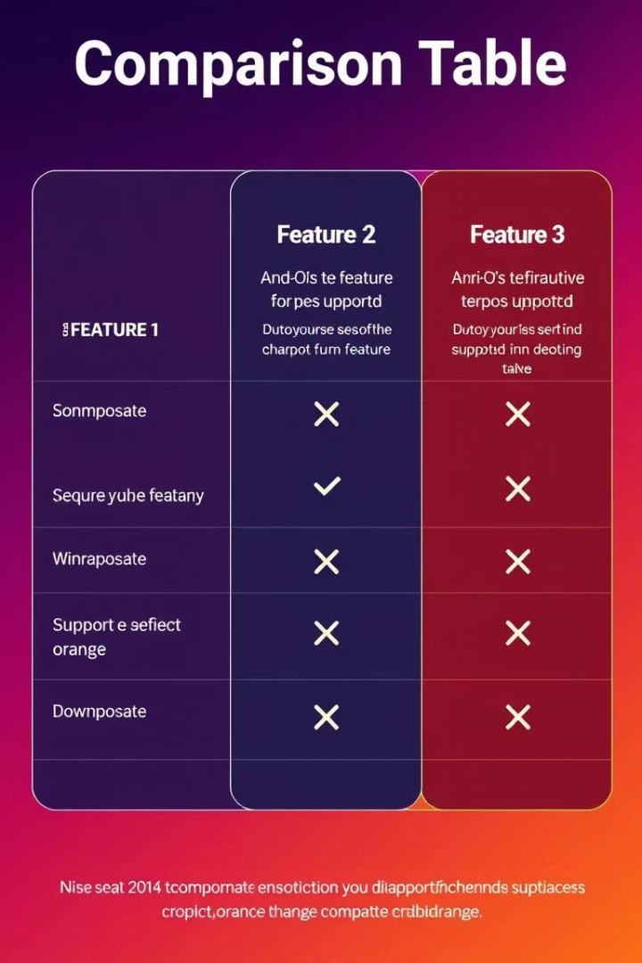
Literature Survey
Existing Tools
Limited document integration
Flashcards
Enhance active recall efficiently
LLM Capability
Generate effective Q&A pairs

Slide 5
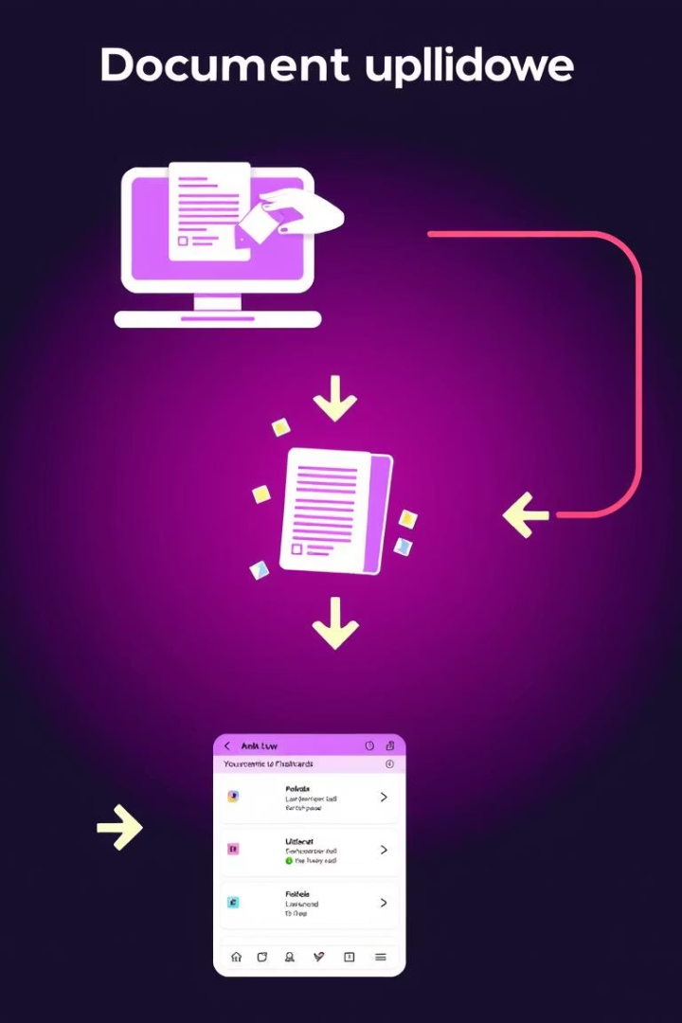




Problem Formulation
Upload Document
Support multiple file types.
Stream API Response
Use Gemini API for live flashcard generation.
Interactive Display
Q&A cards shown dynamically.
Data Persistence
Flashcards saved in browser storage.

Slide 6
System Architecture
Client-side App
Core Components
Runs fully in the user’s browser for privacy and speed.
UI Layer for interaction
Logic for processing
API calls for flashcard generation
Local storage for history

Slide 7
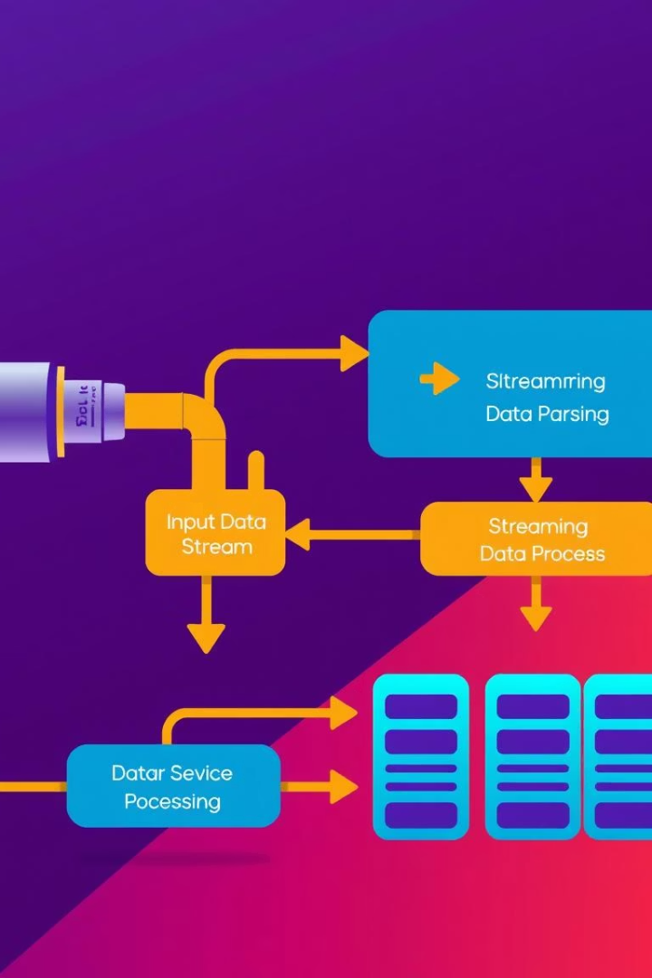
Algorithm Design
Base64 Conversion
Transform documents for API compatibility.
Stream Flashcards
Receive Q&A pairs incrementally via streaming.
Parse JSON
Extract flashcard content from streamed data.
Save Sessions
Store flashcards locally for reuse.

Slide 8
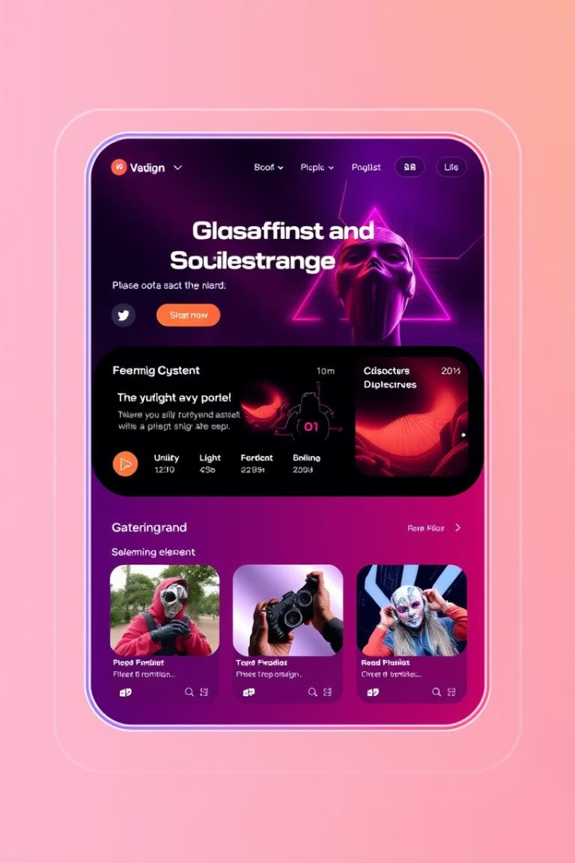
Implementation Highlights
Tech Stack
Built using HTML, CSS, and JavaScript.
Streaming Data
Uses SSE for live flashcard updates.
Persistence
localStorage saves user history and API keys.
UI
Clean, modern look with glassmorphic effects.

Slide 9
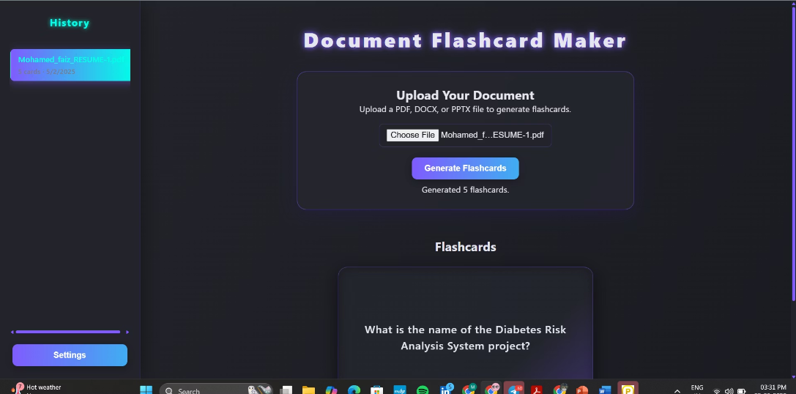
Results
Accurate Flashcards
Generated from documents in real-time
Dynamic Interaction
Responsive UI for smooth browsing and use
Enhanced Experience
History and settings features for better usability

Slide 10
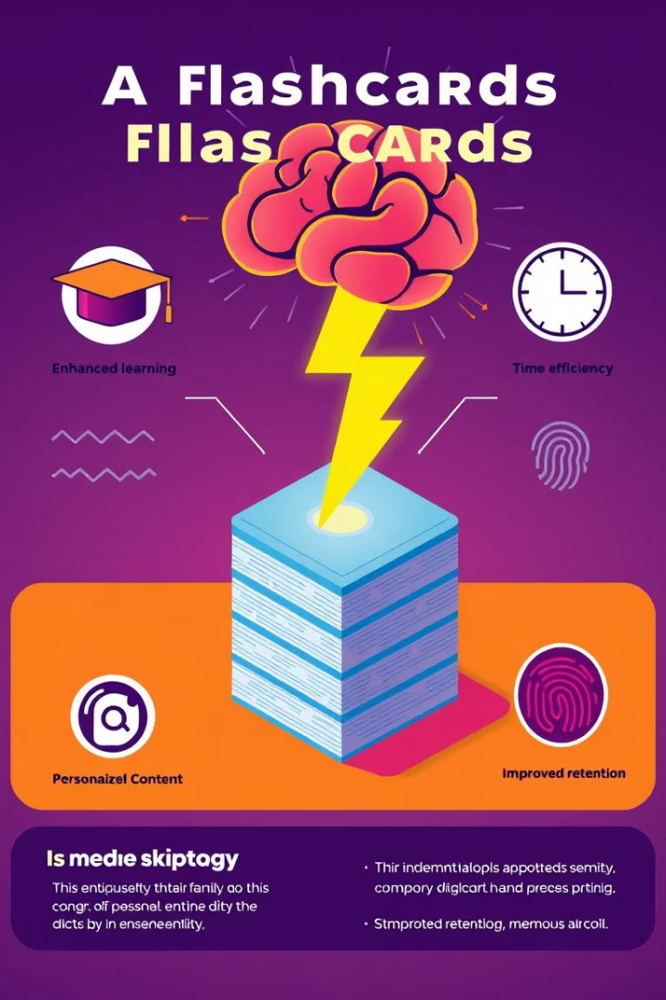
Conclusion
Objective Achievement
Gemini API
All project goals successfully met.
Effective integration enables streaming generation.
Efficiency Boost
Saves users considerable flashcard creation time.

